Slide 1
Financial Institutions and Markets
Group 8 Assignment
Current Status of Indian Debt Market and Trading Practices
By - Abhijeet Shrivastava(17MI3FP08) Mayank Govind Agrawal(17ME3FP13)
Poojitha Pinniboyana(17CE10040)
Rakshit Yadav (19EX20029)

Slide 2
DEBT MARKET
Debt market deals with those securities which yield fixed income group. It establishes a structured environment where these types of debt can be traded with ease between interested parties.
The debt market often called the bond market, fixed-income market, or credit market is the collective name given to all trades and issues of debt securities.
Examples of debt instruments include mortgages, bonds, and Certificates of Deposit.

Slide 3
KEY POINTS OF DEBT MARKET
National governments generally use the proceeds from bonds to finance infrastructural improvements and pay down debts.
Companies issue bonds to raise the capital needed to maintain operations, grow their product lines, or open new locations.
It issues fixed income financial instruments of various types and facilitates trading thereafter.
If mortgages are the main focus of the trading, the debt market may be known as a credit market .
The bond market broadly describes a marketplace where investors buy debt securities that are brought to the market by either governmental entities or publicly-traded corporations.

Slide 4
REGULATORY BODIES
As debt market trade both government and corporate debt instruments , we have following two regulators
1. RBI : It regulates and also facilitates the government bonds and other securities on behalf of governments.
2. SEBI : It regulates corporate bonds , both PSU (Public sector undertaking) and private sector .

Slide 5
PRIMARY BOND MARKET
Primary market – Primary market is the market where the debt instruments are issued for the first time which can be issued as follows -
Public prospectus : Document which contains the details of the offerings which invites public to buy the bond.
Private placement : Invites few selected institutions or investors, as the cost and time of public issuing is quite a large and tedious process.
However , the issuer has to inform the exchanges in case of issuing debts and notify the investors about associated risk changes

Slide 6
SECONDARY BOND MARKET
Secondary market is where the debt instruments can be traded. It can take place by the following two ways based on the characteristics of the investors and the structure of the market are :
Wholesale debt market segment of NSE & Over the counter of BSE : Where the investors are mostly Banks , Financial Institutions , RBI , Primary dealers , Insurance companies , Provident Funds , MFs , Corporates and FIIs .
Retail debt Market : involves participation by individual investors , small trusts and other legal entities in addition to the wholesale investors classes .

Slide 7
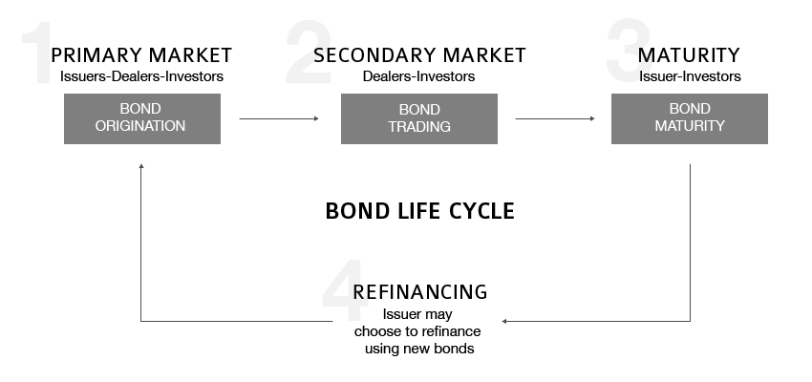

Slide 8
THE DEBT INSTRUMENTS
Government Securities – It is the Reserve Bank of India that issues Government Securities or GSecs on behalf of the Government of India.
These securities have a maturity period of 1 to 30 years. G-Secs offer fixed interest rate, where interests are payable semi-annually.
For shorter term, there are Treasury Bills or T-Bills, which are issued by the RBI for 91 days, 182 days and 364 days.
Corporate Bonds – These bonds come from PSUs and private corporations and are offered for an extensive range of tenures up to 15 years.
Comparing to Government Securities , corporate bonds carry higher risks which depend upon the corporation, the industry where the corporation is currently operating, the current market conditions, and the rating of the corporation.

Slide 9
THE DEBT INSTRUMENTS
Certificate of Deposit – Certificate of Deposits (CDs), which usually offer higher returns than Bank term deposits, are issued in Demat form with a minimum deposit of Rs.1 Lakh.
Banks can offer CDs which have maturity between 7 days and 1 year. CDs from financial institutions have maturity between 1 and 3 years.
Banks and credit unions are the primary issuers of CDs.
Commercial Papers - There are short term securities with maturity of 7 to 365 days issues by large corporations backed only by banks or company promise to pay the face amount by maturity.
A major benefit of commercial paper is that it does not need to be registered with the Securities and Exchange Commission as long as it matures before nine months, or 270 days, making it a very cost-effective means of financing.

Slide 10
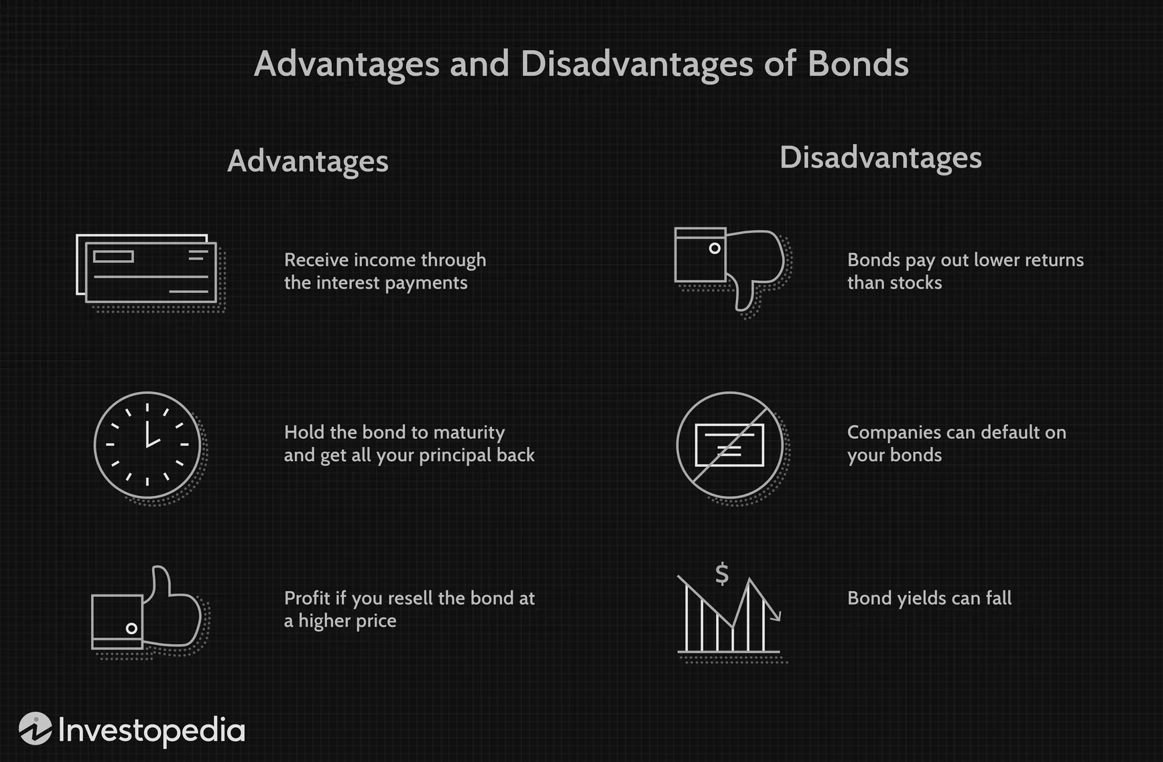

Slide 11
TYPES OF BONDS IN INDIA
Government Bonds- These are known as Sovereign Debt, government bonds are issued by the Central Government to raise money. It is a risk-free investment that offers stable returns and is suitable for investors with a low-risk appetite.
Municipal Bonds- These are issued by the State government or the local government agencies to raise money to fund government. As per SEBI, municipal bonds need to have a rating above the investment grade and should have a maturity period of 3 years, before being issued to the public. These bonds are also considered a safe investment option as they are backed by the State Government.

Slide 12
TYPES OF BOND IN INDIA
Corporate Bonds- Large financial corporations and financial institutions issue corporate bonds to raise money. They offer higher returns but the risk factor is also high. The maturity period on these bonds can go up to around twelve years.
Public Sector Bonds- These bonds are issued by Public sector corporations, where the share of the Central Government is more than 50%. These bonds are implicitly guaranteed by the Union Government and are considered a safe investment.
High Yield Bonds- These bonds are issued by companies who have just entered the market and are yet to establish themselves in the field. They are an extreme version of corporate bonds and thus, offer high returns but have a high-risk factor too.

Slide 13
RISK
Credit risk : While corporate papers carry credit risk due to changing business conditions, government securities are perceived to have zero credit risk. Credit Risk is the risk that the issuer will not pay the coupon income and/ or the maturity amount on the specified dates. Credit Ratings have been established by rating agencies to reflect their opinion of an issuer’s ability and willingness to do so.
Interest rate risk : Interest rate risk is present in all debt securities and depends on a variety of macroeconomic factors. Interest Rate Risk is the risk that interest rates may rise, causing a fall in value of traded debt instruments.

Slide 14
RISK
Settlement risk : The risk that one party will fail to deliver the terms of a contract with another party at the time of settlement is called settlement risk.All debt securities are settled within the specified duration, except in special cases like death of the holder, etc, in which case it may be delayed till all the required formalities are completed.
liquidity risk : The risk arising from the lack of possibility to either buy or sell a security quickly as per one’s requirement is called liquidity risk. Debt securities have minimum liquidity risk and can be easily bought and sold after due listing.

Slide 15
INDIAN BOND MARKET
In India, Bonds are issued by both the Government as well as the private-sector entities, to raise money for a specific purpose. Bonds are like a loan that carries an interest rate and must be repaid on a specified date.
Government and large corporations issue bonds when their funding requirement cannot be met from any other source. These thus, play a major role in fundraising and development activities as the respective organisations could take money for specific purposes through this instrument.
They have a specified maturity period upon completion of which the borrower (Government or Private Corporation) returns the money to the lender. The money will be returned along with the interest, specified at the time of issue.
The Indian bond market is mainly dominated by Government bonds. Government bonds are considered highly secure and enjoy excellent liquidity. The trading volumes in the Indian bond market have increased tremendously over the last ten years and around two dozen entities dominate the market today.

Slide 16
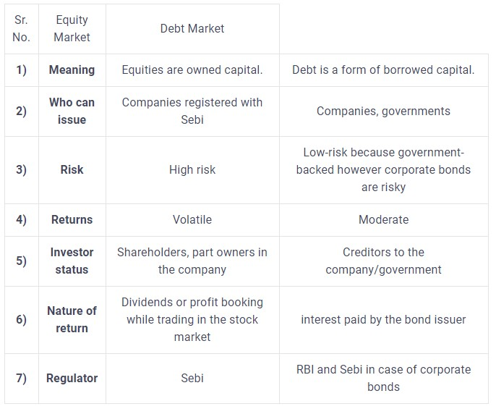
Difference between Equity and Debt Market
Notes:
I dont think it is needed : poojitha

Slide 17
Ways to Invest in Debt Market
Direct investment: You can invest in bonds through private placement directly with the company in case of corporate bonds. In case of government bonds, RBI, the supervisor of government bonds organises auctions for the sale of these bonds. There are two ways in which you can participate in these auctions:
Competitive bidding: Larger investors like mutual fund companies, banks, commercial firms and more participate via competitive bidding because the process is complicated.
Non-competitive bidding: This is an easier process for individual investors like high net worth individuals (HNI), retail investors and likewise. This can be done through online platforms. National Stock Exchange (NSE) has an app called NSE goBid where smaller investors can invest in government securities directly.
Mutual funds: This is an indirect way. The mutual fund industry, irrespective of debt or equity funds work in a similar way. There will be a fund manager that will decides which government securities to invest in. Debt or hybrid mutual funds are an indirect way to stay invested in debt markets.

Slide 18
Indian Debt Market
Classification of Indian Debt Market
The Indian debt market, primarily of the fixed-income variety, can be broadly classified into:
Money Market: Where the borrowing is for tenor of less than a year. Inter Bank Term Money, repo transactions, Certificate of Deposits, Commercial Papers, T-Bills, etc. are some of the money market instruments through which short term requirement of funds are met by banks, institutions and the state and central governments.
Bank and Corporate Deposits: Bank fixed deposits (FDs) have been popular and widely subscribed to, as the feeling of no-default-risk. Corporate deposits are FDs issued by a company (non-bank).
Government Securities: G-Secs are sovereign-rated debt papers, issued by the government with a face value of a fixed denomination.
Corporate & PSU Bond Market: Corporate bonds are issued by public sector undertakings (PSUs) and private firms. These bonds are issued for a wide tenor between 1 year - 15 years. These bonds carry a different risk profile and hence will have associated rating.

Slide 19
Recent Trends in Indian Debt Market
In the past few years, the domestic corporate bond market had seen increasing volumes, largely due to financial investments going into it, including retail participation.
Also, the banks had ceded space to NBFCs over past many years.
This is because banks found it easier to buy securitisation pools to achieve their PSL targets rather than develop competencies that NBFCs had built-in serving affinity groups, in smaller cities & towns.
And post the ILFS crisis, the markets have started shunning non-banks again.
Policy initiative by the government: The various policy initiatives undertaken in the last few years would take time to fructify and to stabilise.
These include the IBC, SEBI’s bond market policies, RBI’s large borrower framework for enhancing credit supply.
Some of these have already seen changes/addendums to the original draft, with the intent being to course-correct, for the stability of the markets.

Slide 20
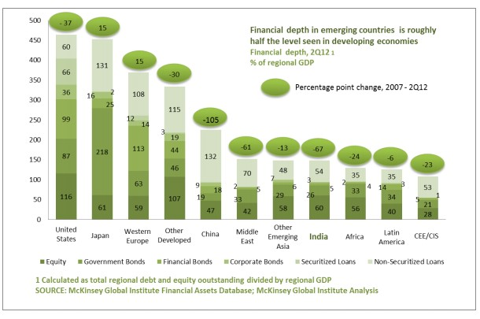
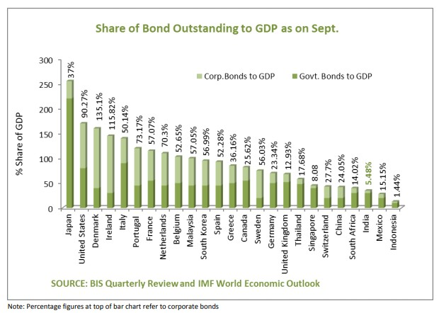

Slide 21
Some Recent Trends in the Indian Bond Market

Slide 22
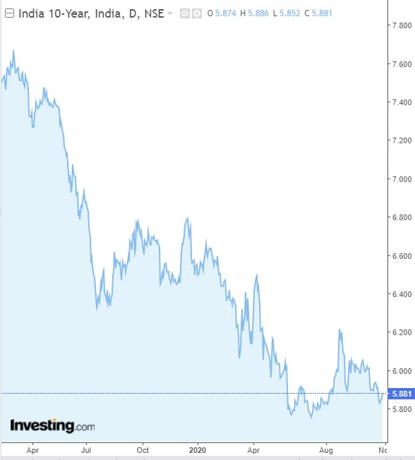
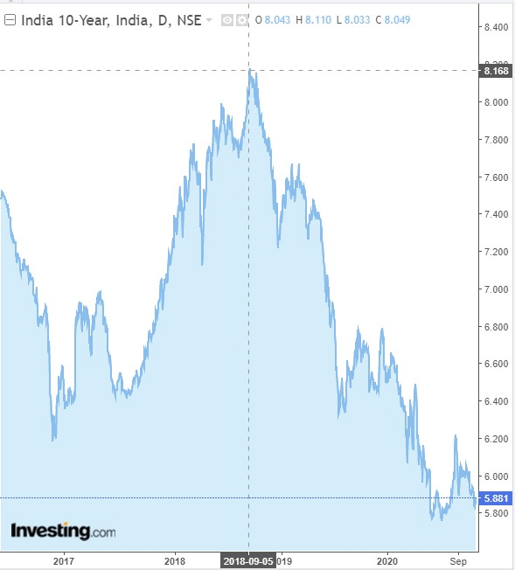
Side By Side Comparison of Bond Yields

Slide 23
Bond Prices fluctuations over past six months
Government bond prices fell to three month low in late July with yields on the 10-year benchmark bond hitting 6 percent on Friday after the Reserve Bank of India (RBI) hinted that it may not cut interest rates further anytime soon because of high consumer inflation.
Since the outbreak of coronavirus and its subsequent impact on the economy and government finances, bond prices and yields have been fluctuating. Over the past one year, the yield curve--which shows the relation between the different interest rates across different tenures--has steepened drastically. Massive liquidity infusion by the RBI in the form of Targeted Longer-Term Refinancing Operations (TLTRO) has brought down short term interest rates.
How have bond prices been moving?
Since mid-April, bond prices had been rallying as yields dropped. The yields on the 10-year benchmark bond, which were trading around 6.2 percent in March, rallied to a high of 6.5 percent in mid-April and fell drastically to 5.7 percent in July.

Slide 24
What is the relation between bond prices and yields ?
Bond price and yields are inversely related, meaning bond prices fall when yields rise and vice-versa
If interest rates are cut when inflation is rising, cheap money could further stoke inflation.
The consumer price index-linked (CPI) inflation for July was 6.9 percent as against 6.23 percent in June.
In March, as coronavirus began to spread rapidly, investors fled equities and other risk assets and sought refuge in bonds, driving up the prices of bonds. RBI's unprecedented rate cuts and liquidity operations to boost India’s growth also supported the bond price rally, causing yields on 10-year government debt to fall to 5.74 percent.
What do high yields signify?
Simply put, high bond yields indicate that the cost of borrowing money has risen. This affects smaller companies more than bigger companies, since smaller companies have limited avenues to raise funds.

Slide 25
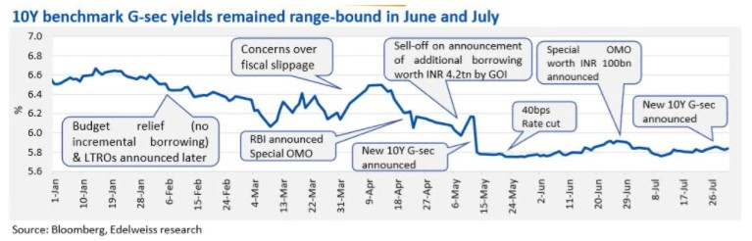

Slide 26
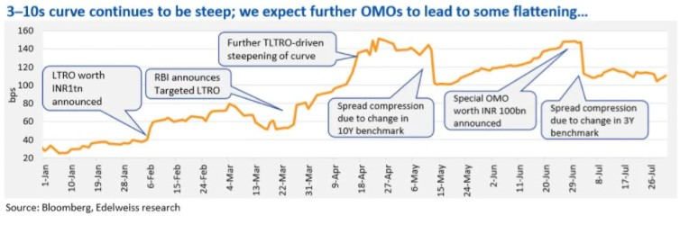

Slide 27
Operation Twist
In the wake of rising inflation rate, RBI’s monetary policy committee (MPC) has hit the pause button on rate cuts in its last meeting. The rate of inflation, as measured by consumer price index (CPI), stood at 6.9 per cent for July, breaching the upper band of 6 per cent. The central bank also expects the inflation rate to remain at the elevated levels in Q2FY21.
The rising rate of inflation has put some restraint on the central bank in using its interest rate mechanism. And the focus has now shifted to other monetary policy instruments, especially Open Market Operations (OMOs).
OMO refers to buying and selling of government securities by RBI to regulate the liquidity in the market. If RBI wants to inject liquidity in the market, it would buy government securities. On the other hand, if it wants to curb liquidity, it would sell government securities.
From last December onwards, RBI has been conducting a special tranche of OMOs, whereby the central bank is simultaneously selling short-term securities and buying long-term securities. Here, the objective of OMO was not to regulate liquidity, but to manage the yield curve, and it came to be known as the Indian version of ‘Operation Twist’.
‘Operation Twist’ was first used by the US Federal Reserve in 1961, and then in 2011, to lift the US economy out of recession. Through ‘Operation twist’, RBI aims to bring down long-term bond yields.
There exists an inverse relationship between bond prices and yields. In the current scenario, as RBI purchases long-term bonds, its demand pushes bond prices upwards. With an increase in the price of long-term bonds, yields would come down. The fall in long-term bond yield will benefit long-term borrowers, as it would bring down the cost of borrowing.

Slide 28
Operation Twist (Contd.)
The government has raised its gross borrowing for FY21 to Rs 12 lakh crore. And, the excess supply of government bonds in the market, especially long-term bonds, has put upward pressure on bond yields. Even in an environment of low interest rates and surplus liquidity, there has not been a commensurate decline in long-term bond yield.
Similarly, a hint of prolonged pause on rate cut has pushed bond yields upward. It is in this background that RBI has decided to conduct simultaneous purchase and sale of government securities under OMO for an aggregate amount of Rs 20,000 crore in two tranches of Rs 10,000 crore each on August 27 and September 03, 2020.
With long-term bond yields coming down, the government would be able to borrow money at a cheaper rate from the market. Similarly, the corporate sector would benefit as yields of corporate bonds would follow a similar line. For instance, if yields on government bonds keep on rising, investors would demand a higher rate on corporate bonds, making them costlier for the corporate sector to borrow.
The OMO by RBI would help reduce the spread between long-term G-sec bonds and corporate bonds. Yet, the widening of fiscal deficit and increased market borrowing by the government could reverse the trend in the bond market. In such a scenario, there is a need for RBI to actively participate in the bond market through OMOs to cool off bond yields.
Why Does the RBI Want Lower Long-Term Interest Rates?
Lower longer-term yields help boost the economy by making loans less expensive for those looking to buy homes, purchase cars, and finance projects, while saving becomes less desirable because it doesn't pay as much interest.

Slide 29
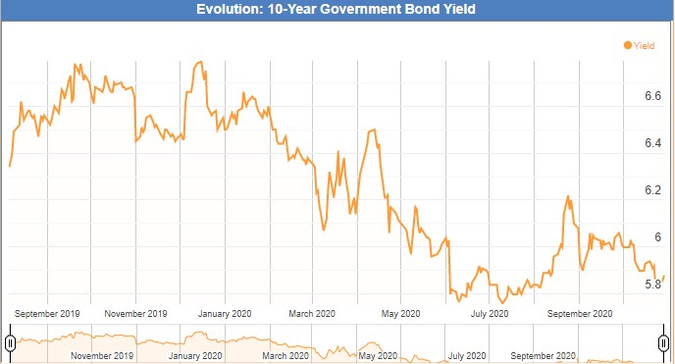
Effect on 10 year government bond due to OT

Slide 30
Effect of Operation Twist on Short term Bond Yields
While Operation Twist and HTM easing measures sought to cool off yield on 10-year G-Secs, short tenure bond yields, left unchecked, have risen.
While the RBI came out with slew of measures recently to ease the rising yield on the 10-year G-Sec, its moves have triggered other worrisome trends in the bond market that can impede transmission.
Aside from announcing two additional tranches of ‘Operation Twist’ (OT), the RBI had eased the held-to-maturity (HTM) limits for bond holdings by banks and also allowed banks to retire higher cost borrowings under previous long-term repo operations.
While these moves had the immediate desired impact of cooling off the yield on 10-year G-Sec by about 20 bps, they have in turn led to an increase in yield of shorter tenure, three- and five-year government bonds by 20-25 bps over the past week.
Given that the movements in three- and five-year government bond yield get transmitted to other bonds, and finally to loan rates, the uncanny rise in short tenure bond yields deters effective transmission of policy rates.

Slide 31
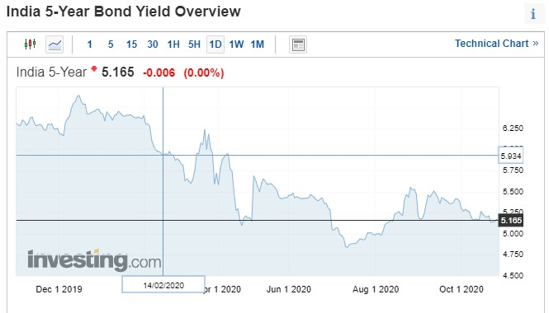

Slide 32
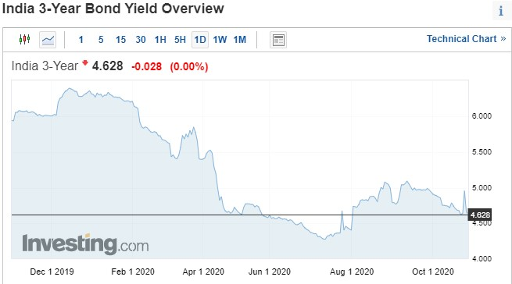

Slide 33
Major Reasons for increase in short-term bond yield
Weak execution
The RBI has been undertaking OT — essentially using proceeds from the sale of short-term securities to buy long-term government debt papers — in a bid to absorb the supply of longer tenure bonds to cap the rise in yield. But the weak execution of this move has created issues. The RBI, for instance, has been buying mostly older bonds under OT. In the recent September 7 auction, aside from this year’s 5.79 per cent 10-year G-Sec, the RBI also sought to buy 6.18 per cent 2024 and 6.97 per cent 2026 bonds, which are older bonds. The August 25 auction comprised purchases of 8.24 per cent 2027 and 7.95 per cent 2032 older bonds, among others.
Furthermore, the window for banks to retire higher cost borrowings undertaken under previous long-term repo operations may well have unintended consequences as some banks may want to sell off the short tenor bonds that they were holding against these borrowings.”
Fiscal worries
The yields on 10-year G Sec have remained sticky, owing to the Centre’s additional borrowing announcement in May (₹12-lakh crore in FY21 from the earlier estimated ₹7.8-lakh crore).
In a bid to ease the risk aversion, the RBI eased the HTM holding norms for banks on incremental purchases from September onwards. Essentially, bonds held under HTM need not be marked to market. By hiking the HTM limit for banks by 2.5 per cent (of deposits) for the second half of this fiscal, the RBI has created an additional ₹3.6-lakh crore of buying window for banks, without having to worry about the fluctuation in bond prices.

Slide 34
Trading Practices
Trading bonds happens many thousands times a day and is an important part of global economic markets. The bond market is far bigger than the stock market and central banks conduct monetary policy in the bond markets. When buyers and sellers are trading their bonds, they dictate the yields of the various types of bonds they are trading. This in turn sets the price of credit in the economy.
Bonds trade anywhere that a buyer and seller can strike a deal. Unlike publicly-traded stocks, there’s no central place or exchange for bond trading. The bond market is an “over-the-counter” market or OTC market, rather than on a formal exchange. Convertible bonds, some bond futures and bond options are traded on exchanges.

Slide 35
Trading Bonds: Dealers and Investors
Bond Dealers:
While investors can trade marketable bonds among themselves, trading is usually done through bond dealers, or more specifically, the bond trading desks of major investment dealers.
These dealers are at the center of a vast network of telephone and computer links that connect all the interested players. They also have traders responsible for knowing all about a group of bonds and quoting a price to buy or sell them, or “making a market” for bonds.
Dealers provide “liquidity” for bond investors so that those investors can buy and sell bonds more easily and with a limited concession on the price, but dealers can also buy and sell amongst themselves, either directly or anonymously through bond brokers.
In all bond trading, the goal is to take a spread between the price the bonds are bought at and the price they are sold at. That spread is how bond dealers make (or lose) money.
Bond trading became very lucrative before the credit crisis, when investment dealers used their banking capital to fund huge inventories of bonds and do mostly proprietary trading. This didn’t end very well, as bond prices fell during the crisis and dealers took huge losses on their inventories. Many banks had to be bailed out by governments and this is why banking regulators now severely restrict proprietary trading activities.

Slide 36
Trading Bonds: Dealers and Investors
Bond Investor:
Trading bonds also involves financial institutions, pension funds, mutual funds and governments from around the world.
These bond investors, along with the dealers, make up the “institutional market,” where large blocks of bonds are traded. A trade involving $1 million worth of bonds would be considered a small ticket in the institutional market. There’s no size limit in this market, where trades worth $500 million or $1 billion at a time can take place.
There’s also no size restriction in the “retail market,” where individual investors buy and sell bonds with the bond trading desks of investment dealers, but the size of those trades is usually under $1 million.

Slide 37
Bond Market Terminology
Coupon: The percentage interest to be paid on a bond in the course of a year. The interest is usually payable semi-annually, although it can also be payable monthly, quarterly, and annually.
Maturity: The date the bond will be redeemed or paid off.
Price: The quoted price is usually based on the bond maturity at a price of par, or 100.00.
Yield :The term “yield” usually means “yield to maturity.” The yield to maturity takes into account the coupon payment, and considers whether the bond is maturing at a different price than its current price.
Bid: The price at which the trader will pay for a bond.
Offer (Ask): The price at which the trader will sell a bond.
Bid-offer spread: The price difference between what the trader will buy a bond at and the price at which the trader will sell a bond. The difference on highly liquid and tradable governmentbonds is usually only a few cents.
Basis points: A basis point is a hundredth of a percentage point. For instance, if a yield moves from 5.5% to 5%, it has moved 50 basis points.

Slide 38
Bond Market Terminology
New issues: Most other governments and corporations use a different system of distributing new issues, namely offering them to investors through bond dealers. The bond dealers earn a commission for distributing the bonds to investors. The offering can be on a fixed price basis, or on the basis of a fixed yield spread to comparable federal government bonds.
Book-based bonds: In recent years bonds have gone “book-based,” meaning that the bonds are lodged with a central trustee and do not physically move from there. Instead, the dealers and institutions have accounts set up with the trustee, and when a bond trade takes place, the buyer’s account is credited with the bonds, while the seller’s account is debited. Most government and corporate bonds are book-based and investors are discouraged from taking physical possession of the bonds.

Slide 39
Why trade Bonds?
A bond trader at an investment dealer seeks to make a profit on his “trading book”. The more money he makes, the greater his bonus. That is why traders have high transactions volumes – because the more they trade, the more money they will make.
A hedge fund trader will trade similarly to an investment dealer but use more “leverage,” or borrow money against the bonds the fund owns. Hedge fund traders also make many trades to maximize their profits.
A “Buy Side” bond trader usually holds her bonds for longer periods, given the long-term nature of their portfolios. Insurance companies and pension funds have very long-term liabilities and need to always hold bonds.

Slide 40
Trading Bonds: Low Profile but very important
Bond trading is lower profile than stock trading but it is more important. Bond dealers and bond investors alter their portfolios in light of changing market conditions to make a profit and/or maximize the return on their portfolios. The overall effect of all this bond market activity is the prevailing level of interest rates in an economy, which affects almost all types of credit and lending.

